Slide 1

LIGHTNING TALKS
INTERPROFESSIONAL EDUCATION: CONNECTING US ALL
Paige Brown, pharmd
Assistant Dean of Interprofessional Education
Associate Professor, Pharmacy Practice
College of Pharmacy & Health Sciences
February 17, 2023

Slide 2

“Interprofessional education occurs when students from two or more professions learn to enable effective collaboration and improve health outcomes.
Once students understand how to work interprofessionally, they are ready to enter the workplace as a member of the collaborative practice team. This is a key step in moving health systems from fragmentation to a position of strength.”
World Health Organization (WHO). (2010). Framework for action on interprofessional education & collaborative practice. Geneva: World Health Organization.

Slide 3
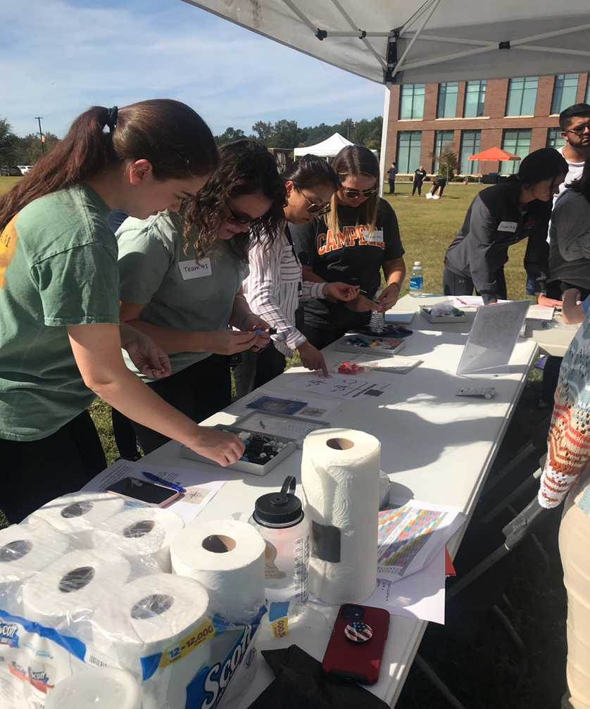
IPE
interprofessional education
"occurs when learners from two or more professions learn about, from and with each other to enable effective collaboration and improve health outcomes.”
–World Health Organization, 2010.
IPCP
interprofessional collaborative practice "occurs when multiple health workers from different professional backgrounds provide comprehensive health services by working with patients, their families, carers (caregivers), and communities to deliver the highest quality of care across settings."
-World Health Organization, 2010.

Slide 4

CORE COMPETENCIES FOR INTERPROFESSIONAL COLLABORATIVE PRACTICE
Values/Ethics for Interprofessional Practice: Work with individuals of other professions to maintain a climate of mutual respect and shared values.
Roles/Responsibilities: Use the knowledge of one’s own role and those of other professions to appropriately assess and address the health care needs of patients and to promote and advance the health of populations
Interprofessional Communication: Communicate with patients, families, communities, and professionals in health and other fields in a responsive and responsible manner that supports a team approach to the promotion and maintenance of health and the prevention and treatment of disease
Teams and Teamwork: Apply relationship-building values and the principles of team dynamics to perform effectively in different team roles to plan, deliver, and evaluate patient/population-centered care and population health programs and policies that are safe, timely, efficient, effective, and equitable
Interprofessional Education Collaborative, 2016

Slide 5
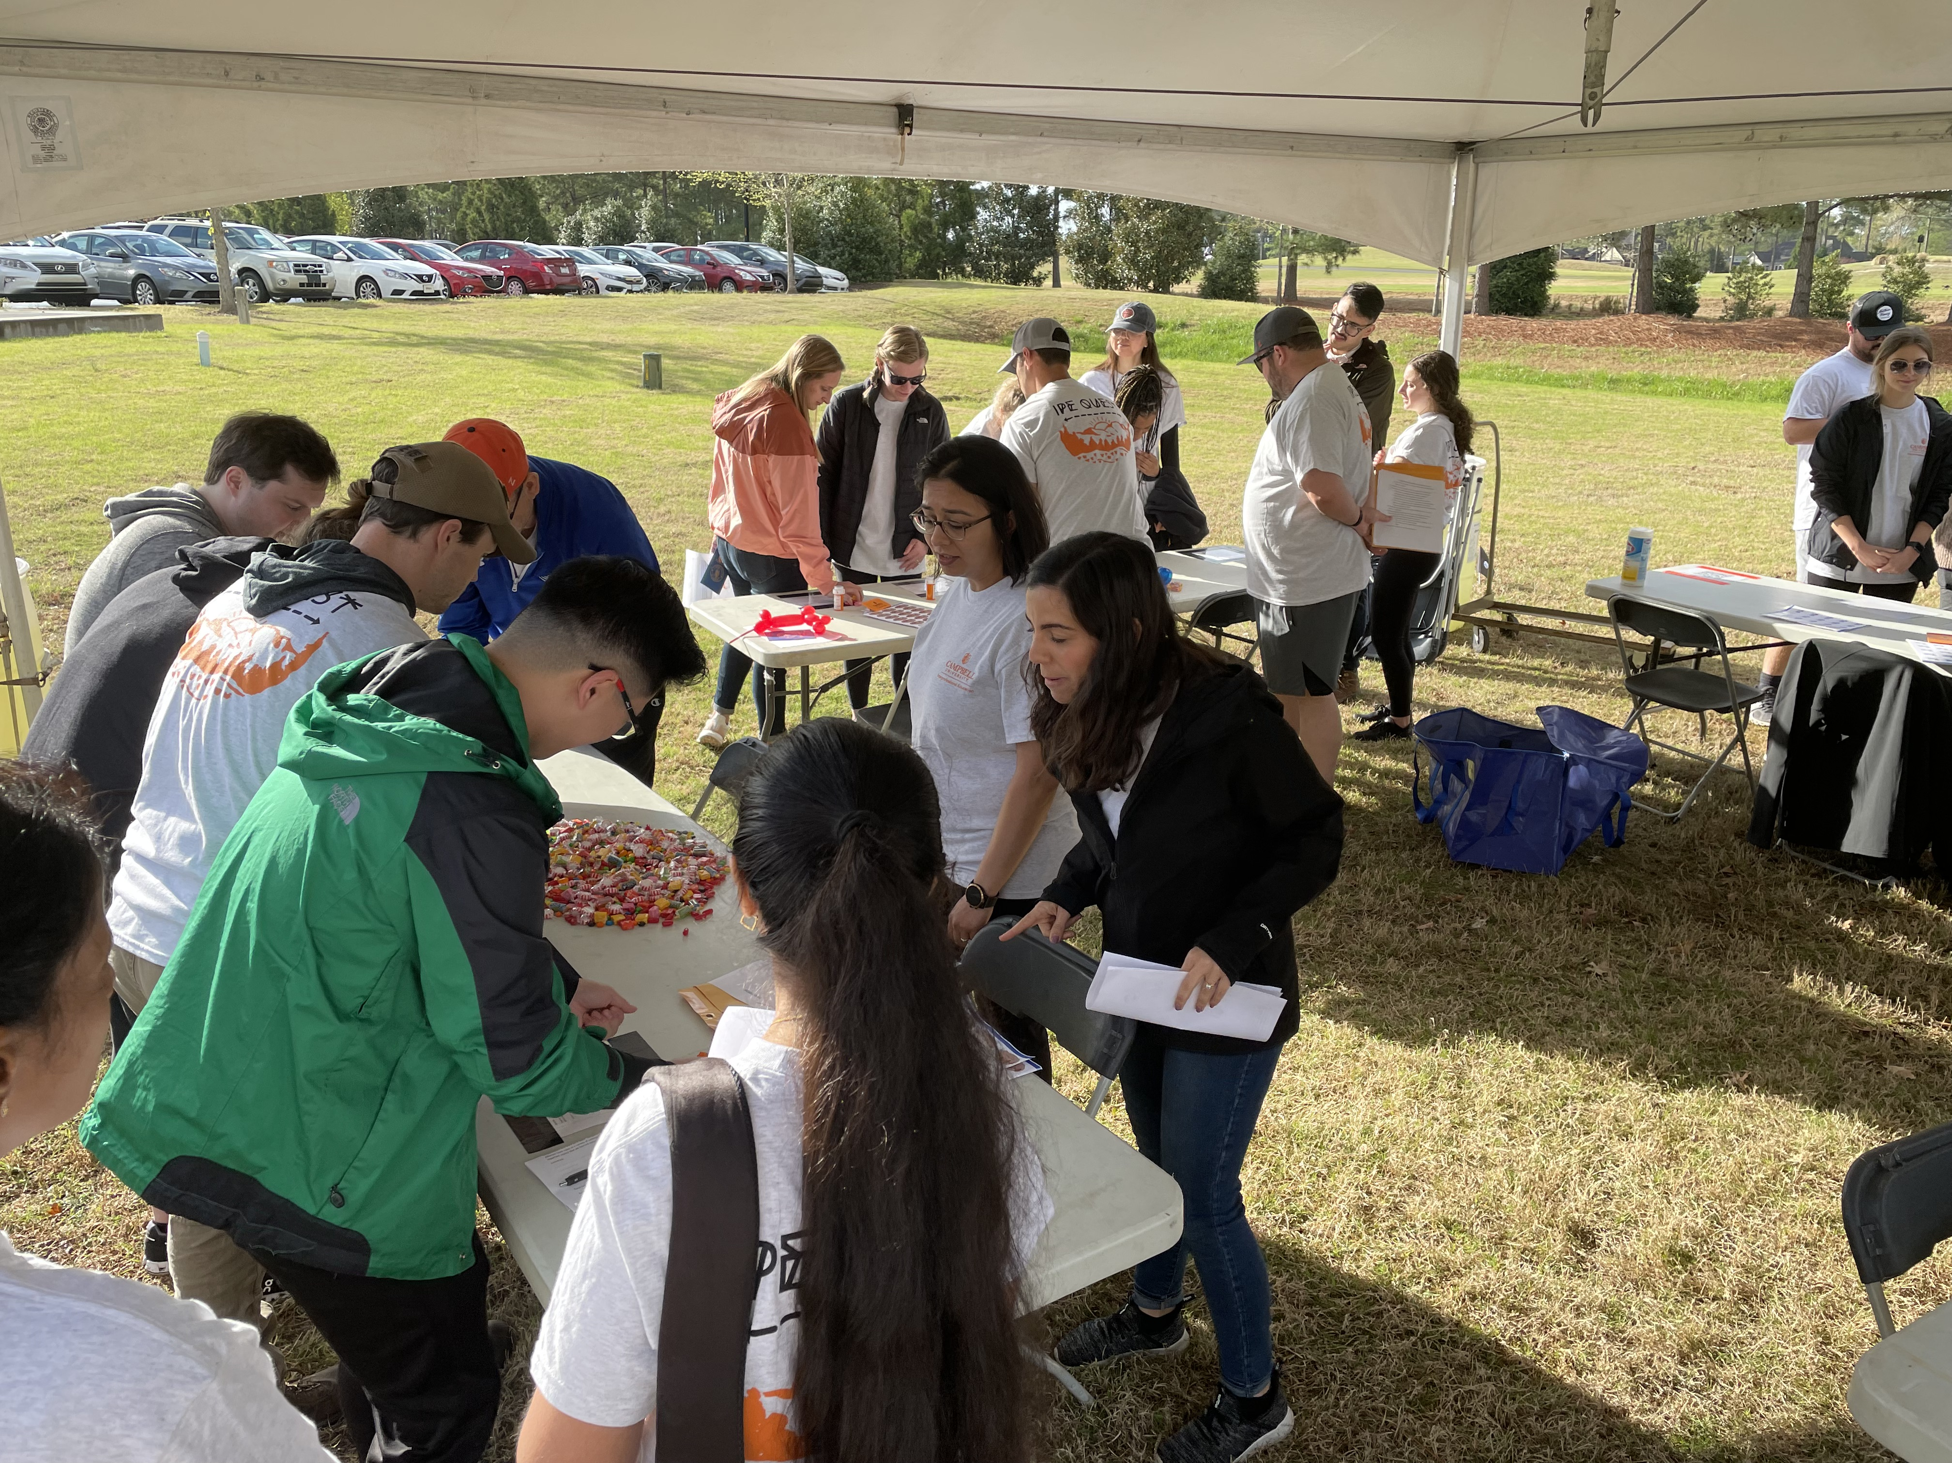
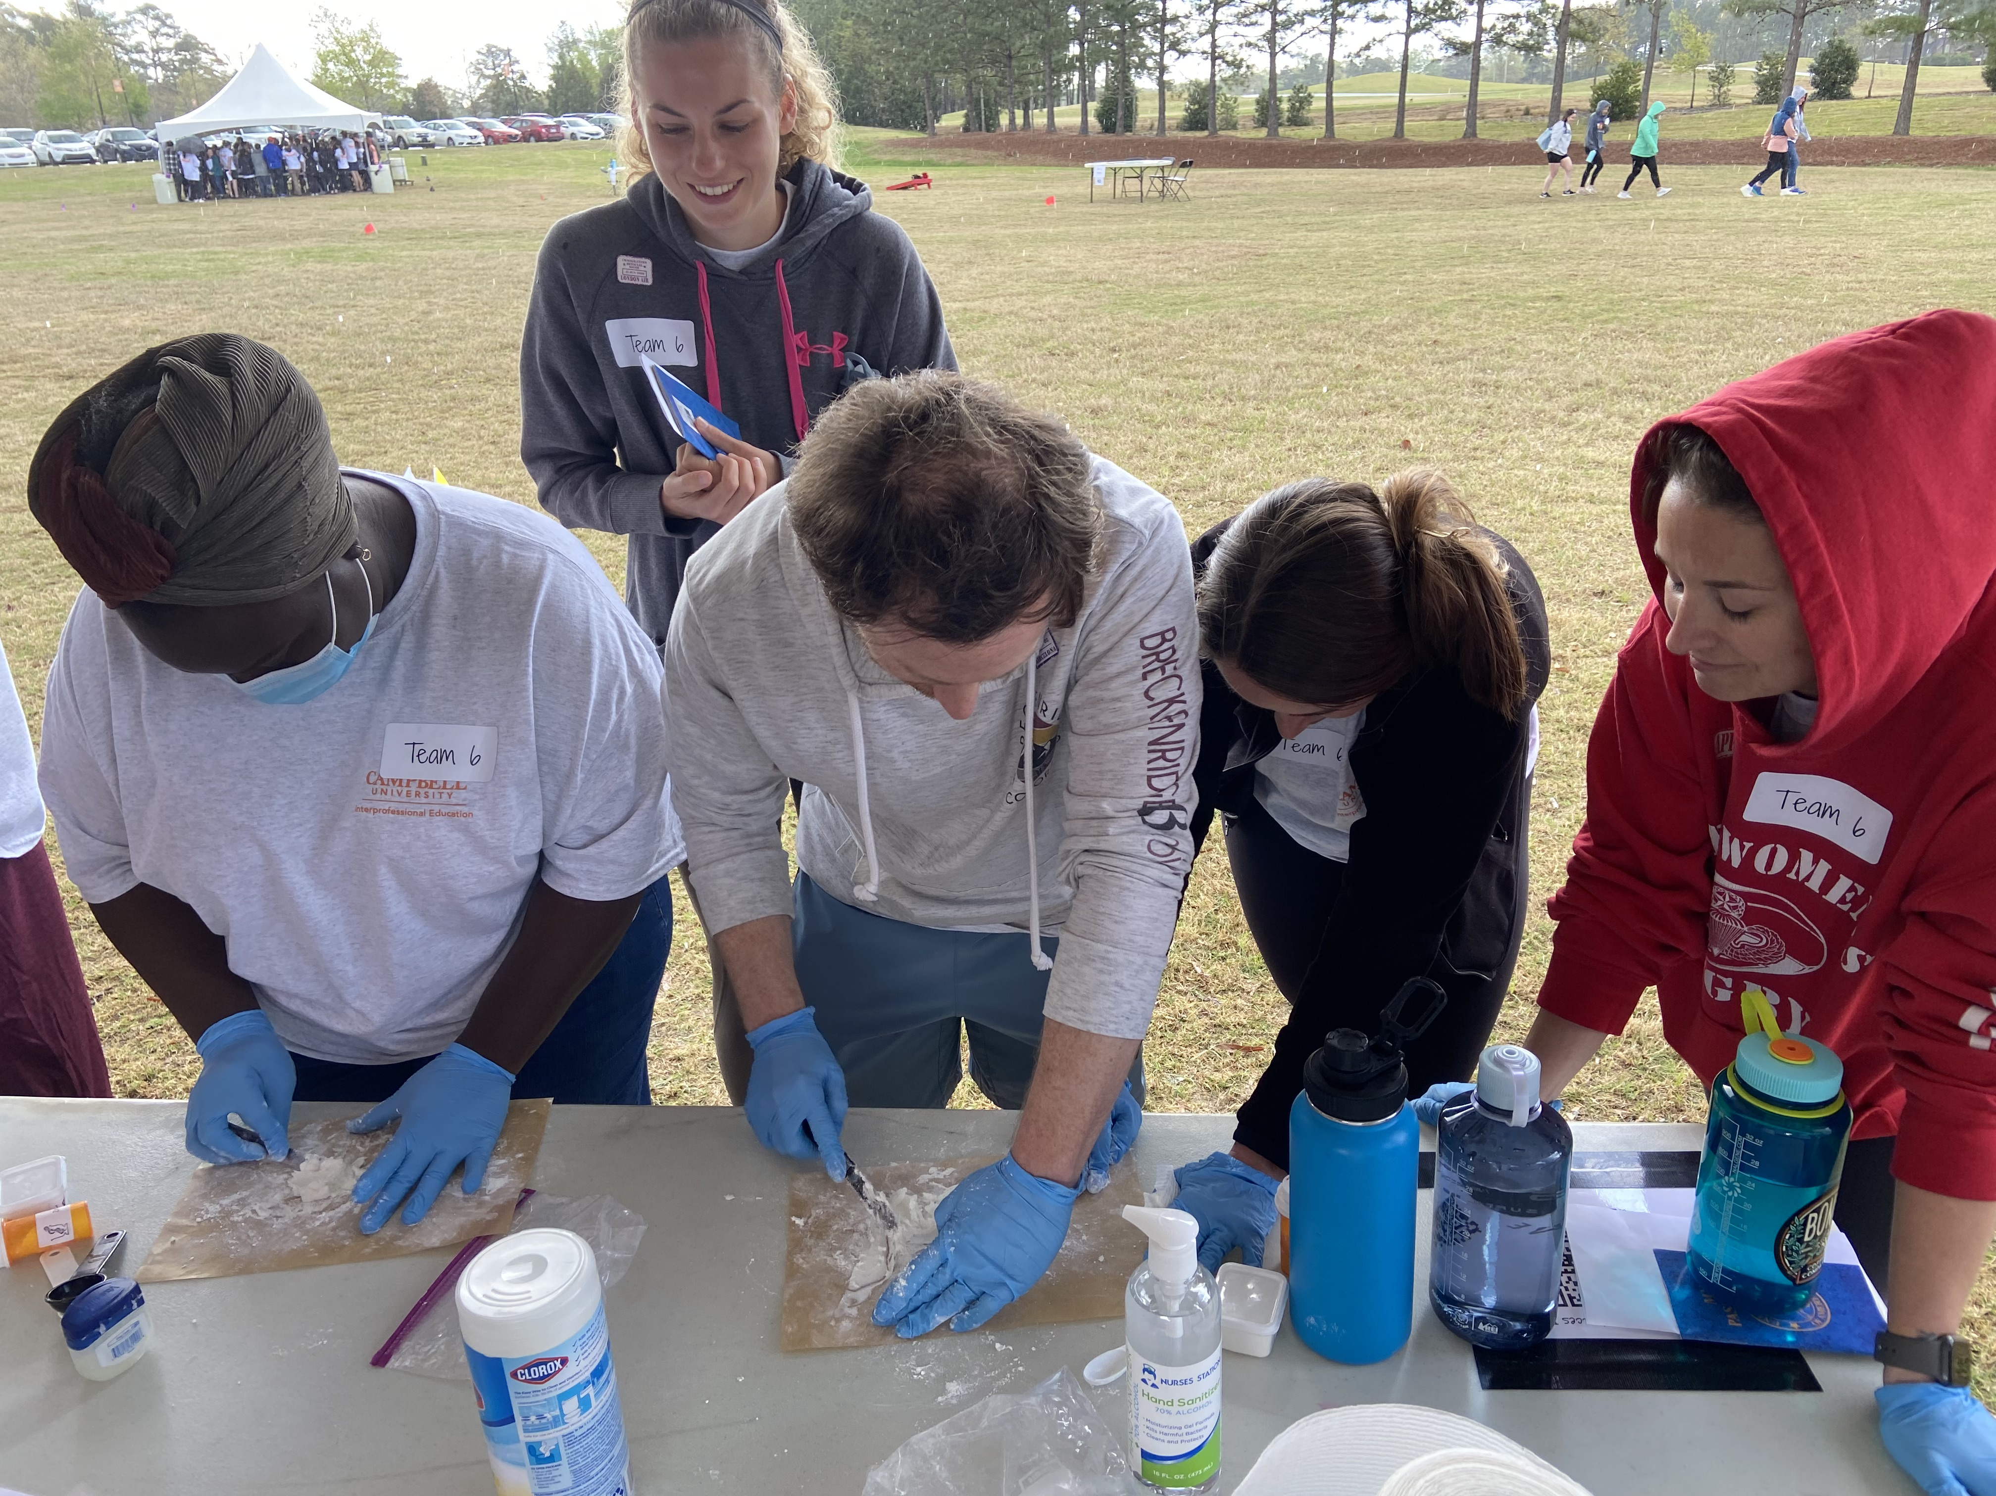
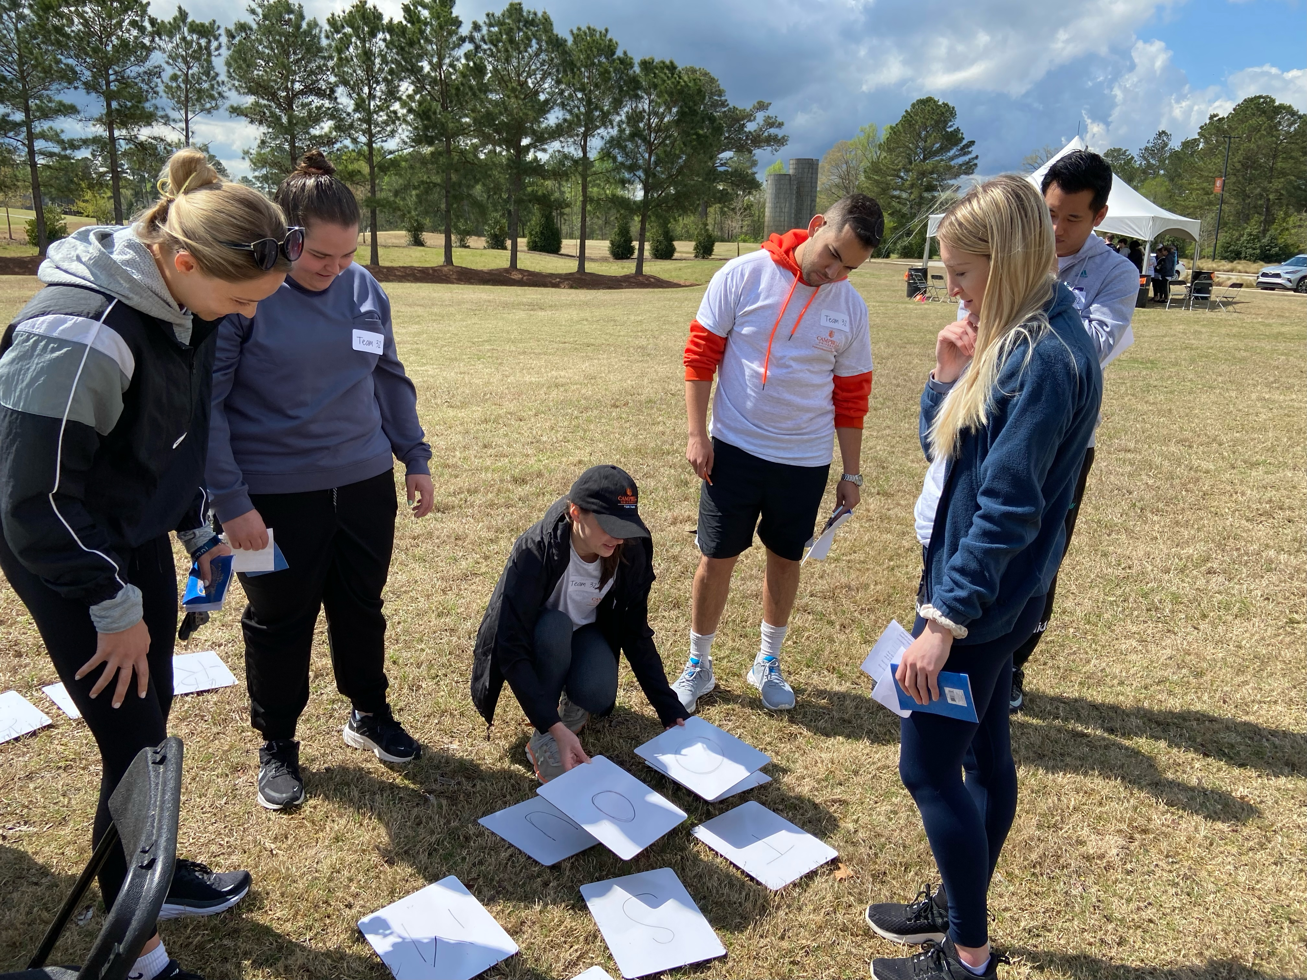
P R O G R A M
A C C R E D I T A T I O N
The accrediting body for each program (e.g., ARC-PA, CCNE, ACPE, CEPH, COCA, CAPTE, etc.) lists requirements for IPE experiences.
BREAKING DOWN SILOS
IPE prepares future healthcare professionals to overcome barriers to collaboration among the healthcare team.
BETTER PATIENT OUTCOMES
Interprofessional collaborative practice, patient-centered medicine and team-based care, rather than "siloed" and isolated care, results in better patient outcomes and improved community health.

Slide 6
EVENTS and Participating Programs
PROGRAMS
  Clinical Research
  Nursing
  Osteopathic Medicine
  Pharmaceutical Science
  Pharmacy
  Physical Therapy
  Physician assistant
  Public health
EVENTS
  First Year Event
  IPE QUEST
  IPE REPS
  IPE PLACES
  Social Events
  CICS
  Activity day
Programs
  Wallace Fellows
  IPE Leadership Recognition Program
  IPE INFORM

Slide 7
Research in IPE
Data collection from various events

Slide 8
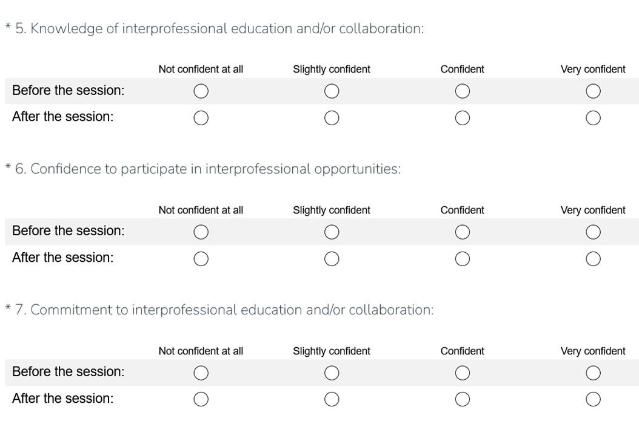
Assessment Tool
13 question survey
Included questions on:
  Responsibility of preparation for event
  Application of information learned
  IPE knowledge, confidence, commitment, communication, and roles/responsibilities
  Major takeaways
  Overall ranking of event (Scale 1 to 5)
  Suggestions for changes or improvements

Slide 9
IPE QUEST Findings
Across all programs, there were statistically significant improvements in:
  Knowledge of Interprofessional Education and/or collaboration from before to after the event
  Confidence to participate in interprofessional opportunities from before to after the event
  Recognizing the roles and/or responsibilities of the other health professions students in the event from before to after the event
  Recognizing your own role as a member of an interprofessional team in the event from before to after the event
  Communicating with the other health professions students at the event from before to after the event
The pharmacy program had the most statistically significant improvement in all question areas, followed by nursing and then physician assistant

Slide 10
IPE QUEST Findings

Slide 11
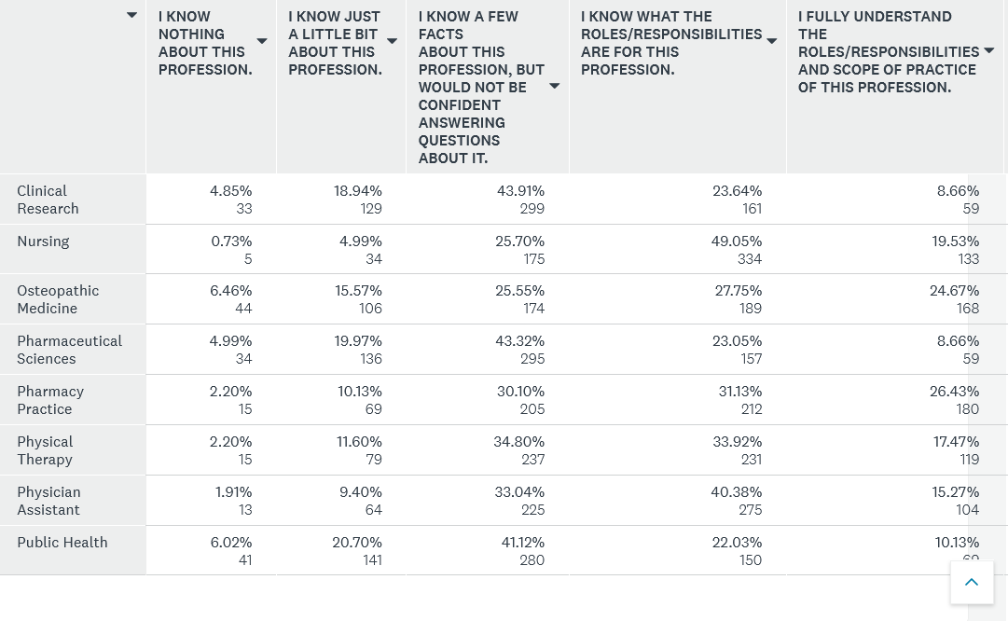
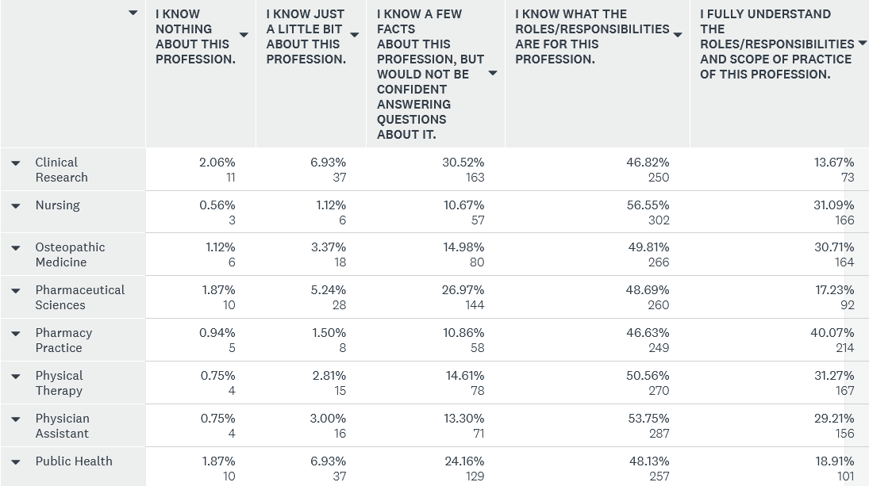
REPS DATA
Pre-Event Survey
Post-Event Survey

Slide 12
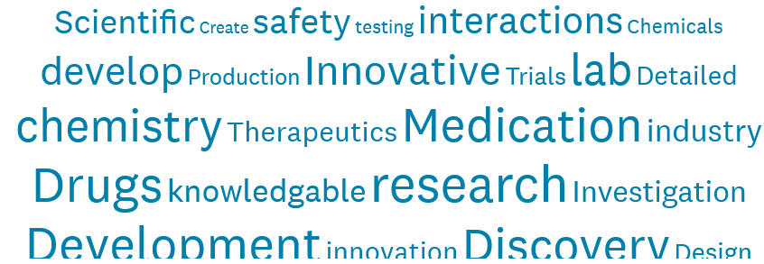
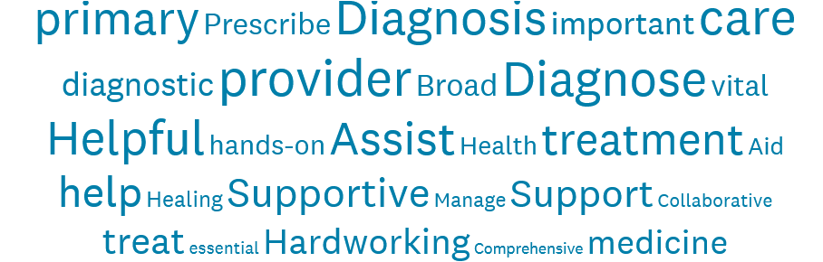
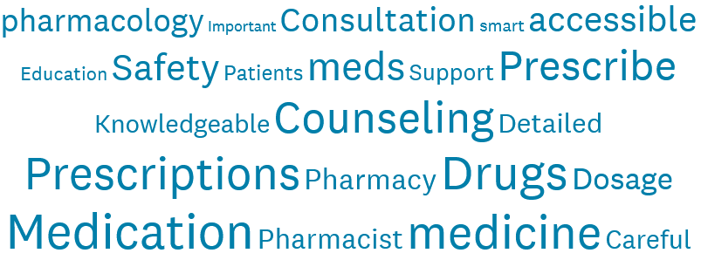
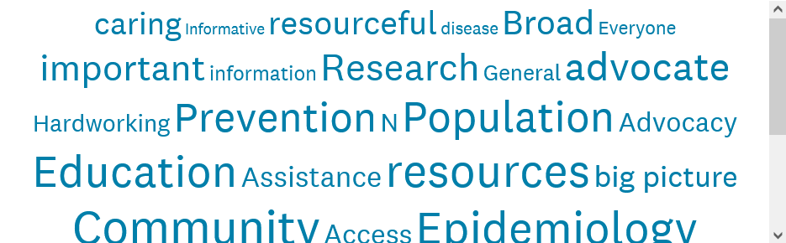
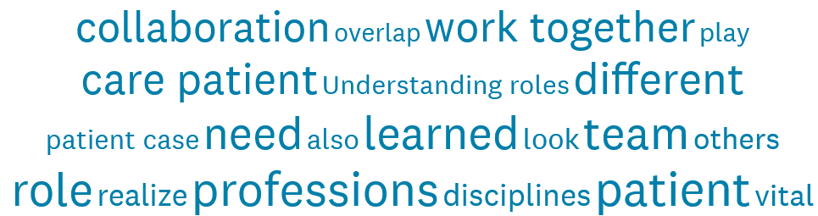
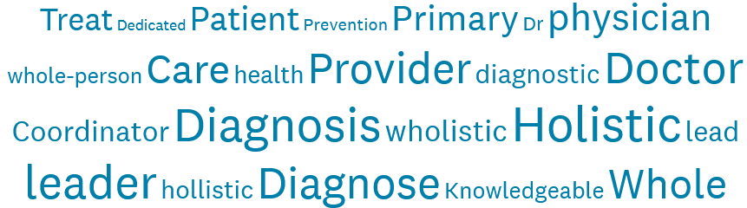

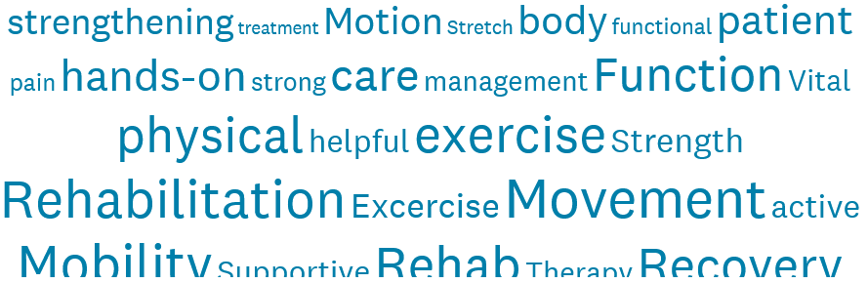

Assessment of REPS
Pharm Sci
PA
Pharmacy
Overall
Public Health
DO
Nursing
PT
Clinical Research

Slide 13
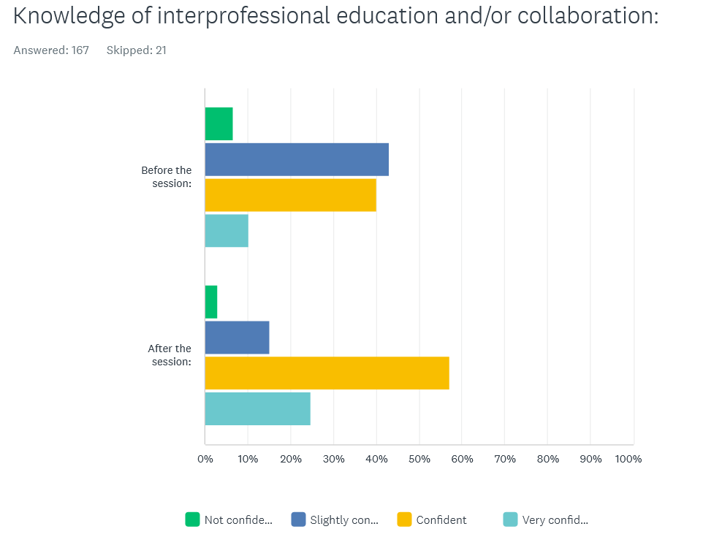
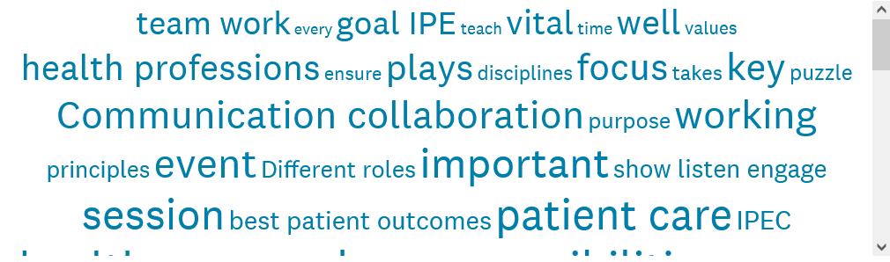
First Year Event Data

Slide 14
Moving Forward
Use data to build new programming
Analyze data for changes in knowledge, skills, behaviors, and attitudes
Adapt programming and events based upon analysis
Validate assessment tool and publish more results of work

Slide 15

Questions?

Slide 16
LIGHTNING TALKS
INTERPROFESSIONAL EDUCATION: CONNECTING US ALL
Paige Brown, pharmd
Assistant Dean of Interprofessional Education
Associate Professor, Pharmacy Practice
College of Pharmacy & Health Sciences
February 17, 2023

